Slide 1
Understanding
Convolutional Neural Networks on Protein Secondary Structure Prediction
Guillermo Romero

Slide 2
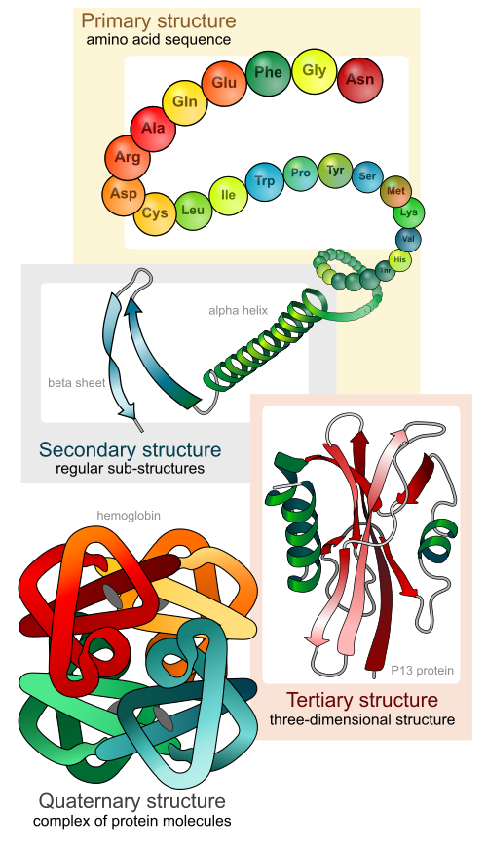
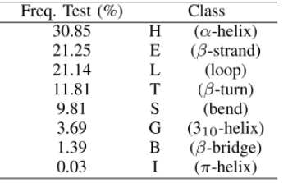
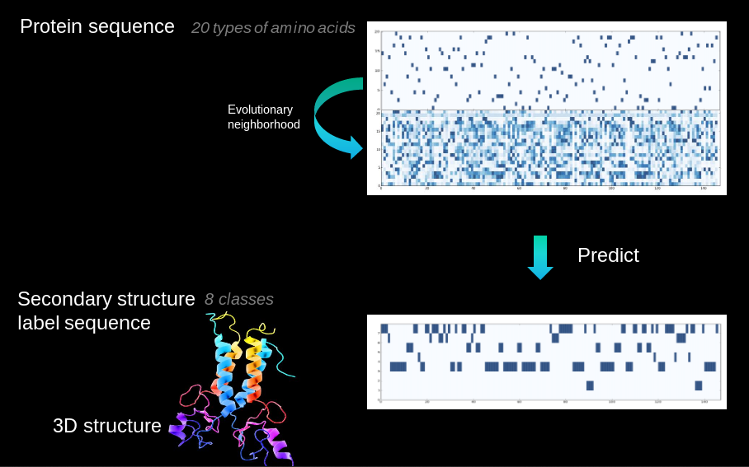
Notes:
- Proteins fold into 3D structure, which determines their function
- Drug, enzyme design,
- High cost of experimental protein structure determination and low cost of DNA sequencing
- 85M proteins discovered, 130k 2ary struct known
- Extremely challenging 3D from sequence alone
- Intermediate step (constrains): secondary structure, local conformations of peptide backbone alpha-helix (3), beta-strand (2), coil (3)
- Structural labelling: many-to-many sequence problem
- Other problems: backbone angle, contact number, solvent accesibility area. Many-to-one: intrinsic disorder prediction, subcellular area

Slide 3
Network of analysis
My own network (simple)
Three convolutional layers, with filters of size 3, 5 and 7, and 16 filters per size
Skip connections from all previous layers (a la ResNet)
Accuracy 67.7% (similar to the state-of-the-art from 2 years ago, currently it’s around 70%)
Total window size: 19 (9 per side)
With the new model all saliencies can be calculated in 3 days (as compared to the 240 days of the previous model)

Slide 4
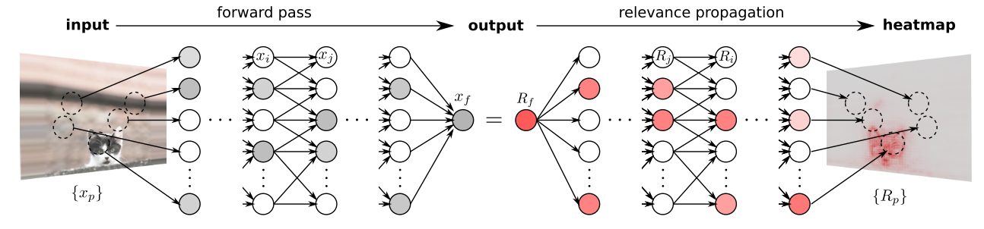
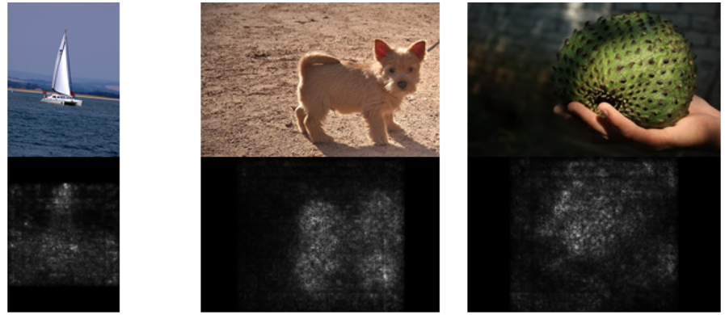
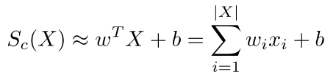

Saliency Maps
First order derivatives (Taylor expansion)

Slide 5
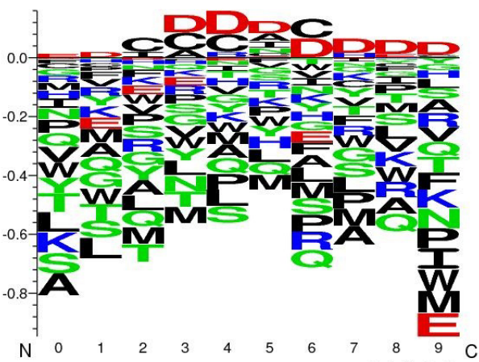
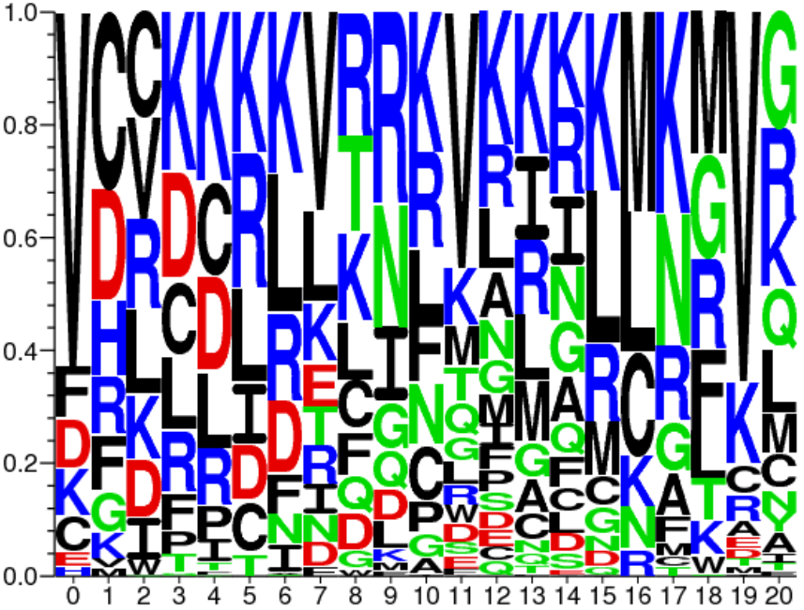
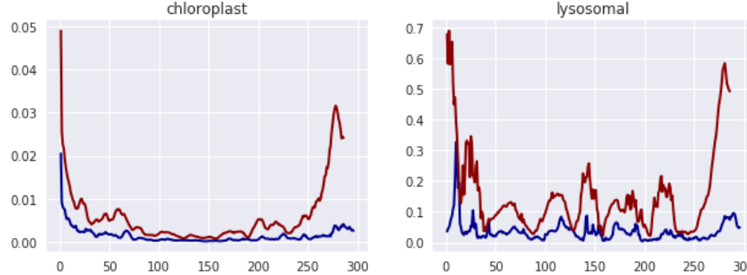
Previous work of model understanding with biological sequence data
A. Fontal, Neural Networks for Subcellular Localization Prediction, Wageningen University & Research, 2017.
Activation maximization
No prior, potentially
unnatural samples
No convergence
1st filters
representation
Only 1-layer of CNN
Signal
Masking
approach

Slide 6
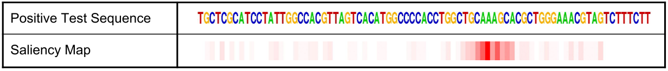
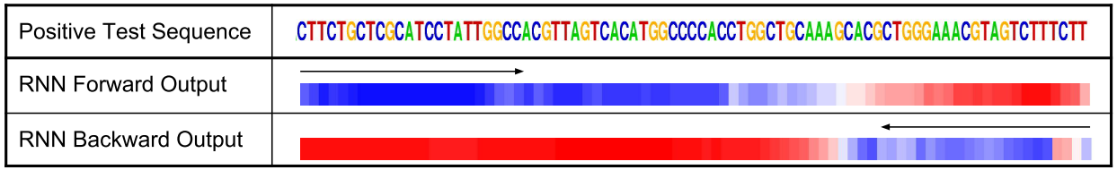
J. Lanchantin, R. Singh, B. Wang, and Y. Qi, Deep Motif Dashboard: Visualizing and Understanding Genomic Sequences Using Deep Neural Networks, 2016.
Transcription factor binding (TFBS) site classification task on DNA sequence
Saliency maps
Activation maximization
Temportal output scores For LSTMs

Slide 7
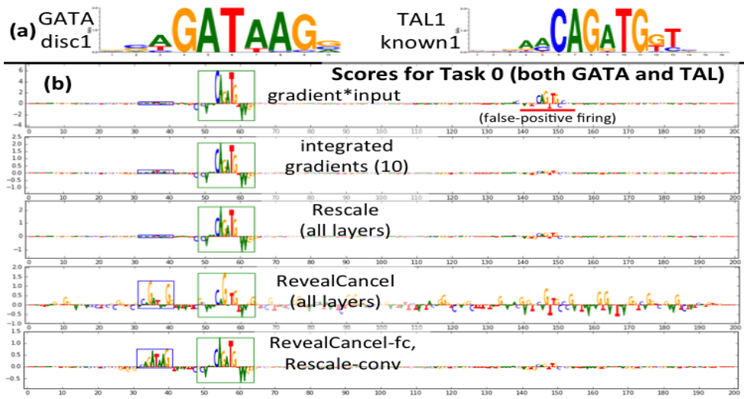
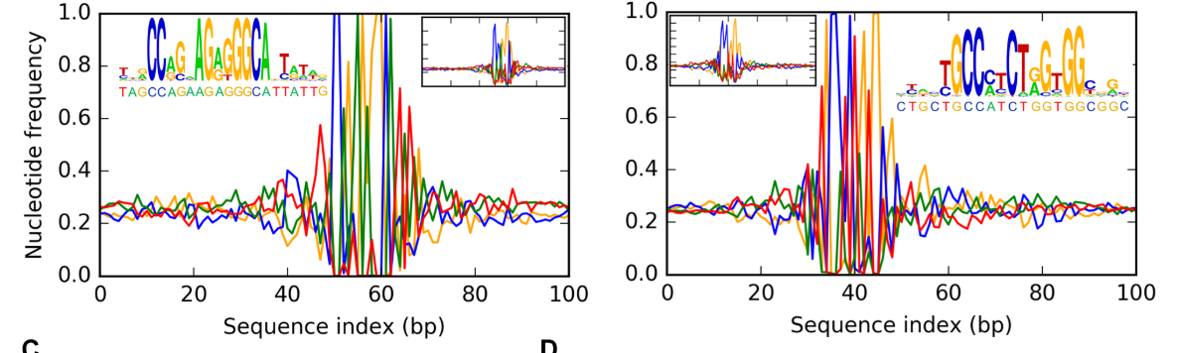
A. Shrikumar, P. Greenside, and A. Kundaje, Learning Important Features Through Propagating Activation Differences, Apr. 2017.
Develop new way of
  calculating saliencies
I’m currently
using this one
A. Finnegan and J. S. Song, Maximum entropy methods for extracting the learned features of deep neural networks, PLoS Comput. Biol., 2017.
Probabilistic methods
with MCMC
on DNA sequences

Slide 8

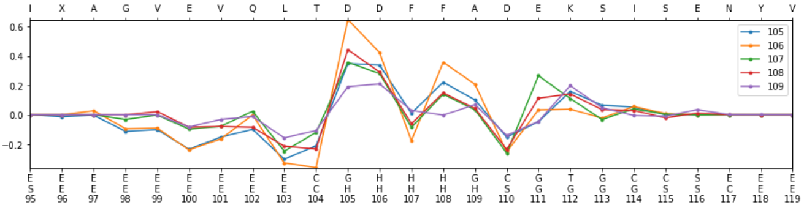
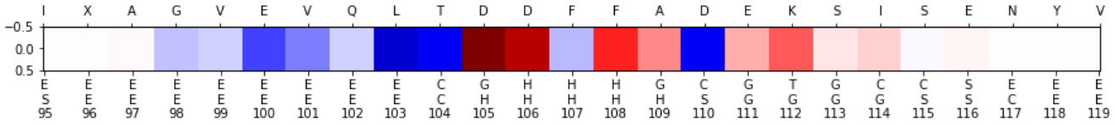
My saliency maps I
For a single sequence:
  Plotting the saliencies per single position (up) (aggregated by pssm)
  Or aggregating all positions on a single map (down)
  Could also be shown as SeqLogo like
Prediction
Truth

Slide 9
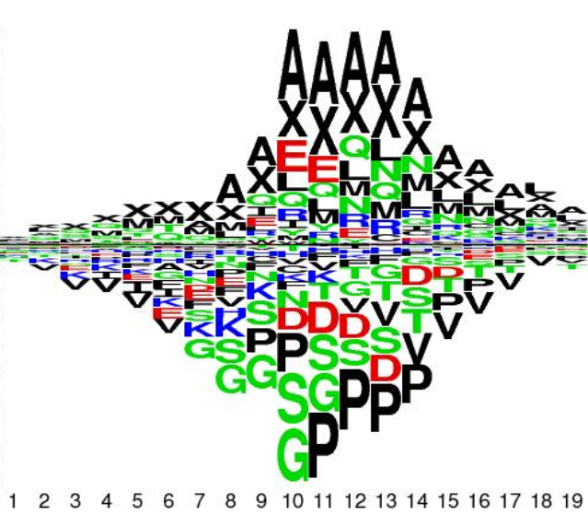
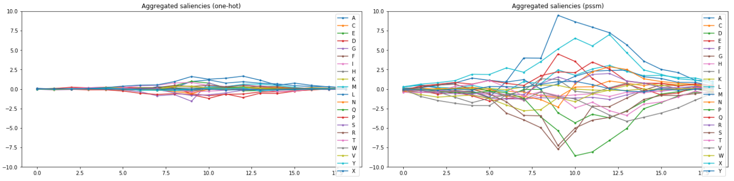
My saliency maps II
Aggregating saliency maps
  Either sheer addition of saliencies (shown)
  Performing clustering on saliencies (with cosines of angles as distances)

Slide 10
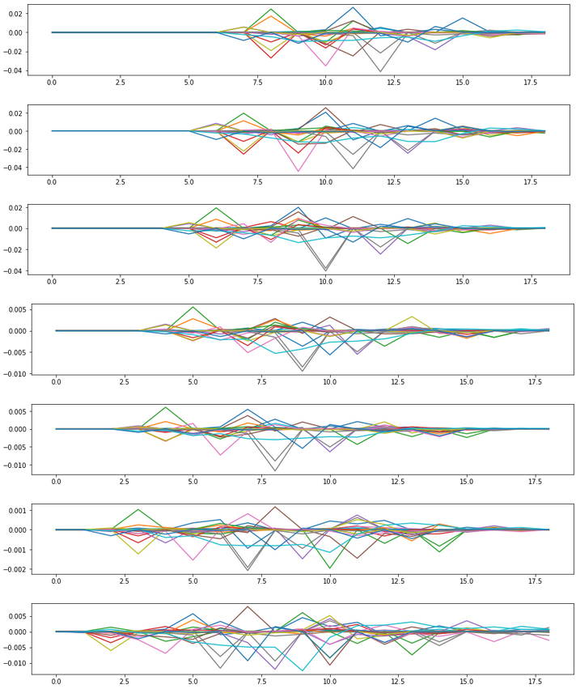
Problems with saliency aggregation
On the right, saliencies of subsequent single positions. Each line of a plot represents one aminoacid. Each plot corresponds to one position. X axis is the window size (19)
Motifs slide through the saliencies, which makes:
  Sheer aggregation to capture the sliding effect
  Clustering of full saliencies useless

Slide 11
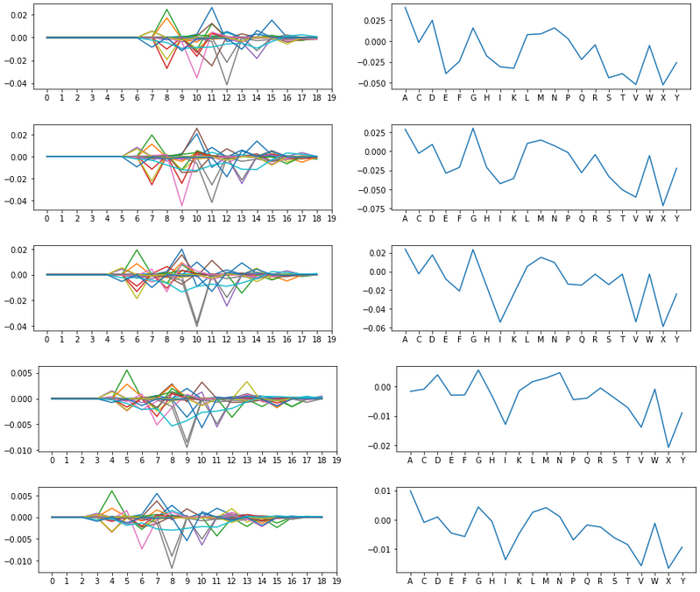
Clustering saliencies
By aggregating each saliency on its window length (right), the motifs are preserved
Clustering on the saliencies (cosine) in the positions with high prediction for one class can show different kinds of motifs that activate that class

Slide 12
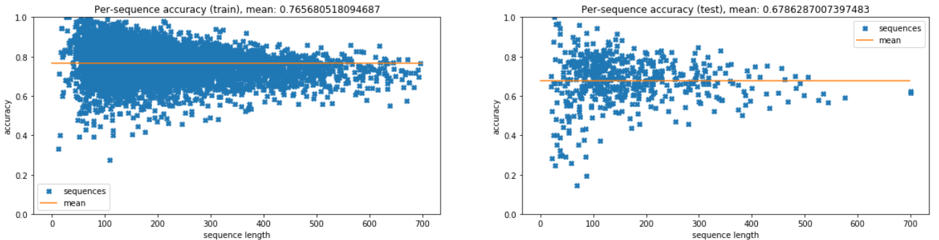
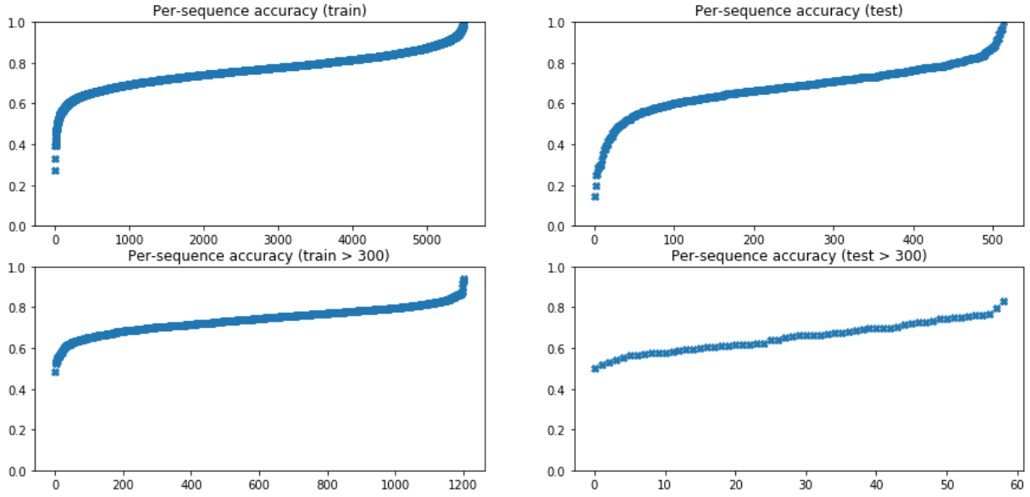
Spotting worst classified sequences
Here, all sequences sorted by their mean accuracy
Here, all sequences above 300 amionacids long, sorted by their mean accuracy

Slide 13
What’s next? (wrapping up)
Apply saliency aggregation of the 6K sequences for each of the 8 classes
Develop and implement cosine clustering on the saliencies
Start writing report
If there is enough time
Analyze worst predicted sequences by comparing their functions on SwissProt
Re-train network but using only pssm and check if accuracy does not change significantly

